Slide 1

LAB- 4 Quantization, A/D, and D/A Operations
Goals: To understand the concept of quantization as applied to the conversion of analog voltages into digital words and digital words into analog voltages.

Slide 2
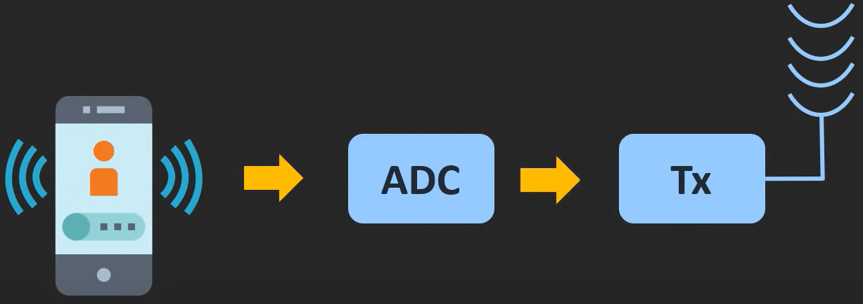
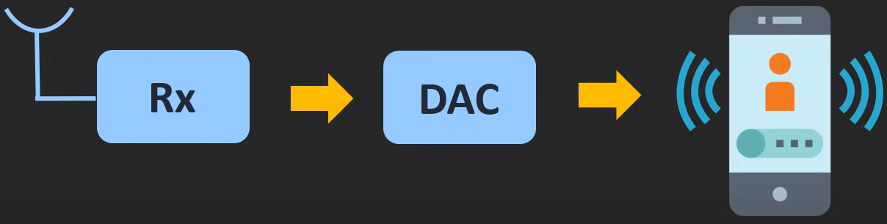
Introduction:
we all are using this ADC and DAC in our day to day life.
Example:
whenever we are streaming the music on our smartphone then this digital bit stream is converted into the electrical signal and through the smartphone speaker, we are able to hear this music. And here this DAC inside the smartphone converts the digital bit stream into the analog signal.
Similarly, while talking on the phone, the microphone converts our voice into the electrical signal and using this ADC this signal is digitized and it is transmitted in the form of radio waves.
Similarly, at the receiver side, using the DAC this received digital data is converted into the analog signal and through the speaker, we are able to hear the voice of the other person.

Slide 3
Why we use ADC and DAC ?
Susceptible to Noise
Analog Signal : Difficult to Process in Analog Domain
Difficult to Store in Analog Domain
Less Susceptible to Noise
Digital Signal : Easy to process in Digital Domain
Easy to Store in Digital Domain

Slide 4
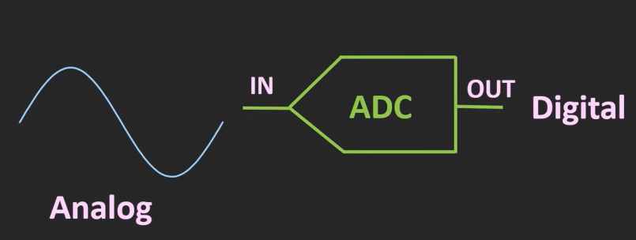
A/D Conversion:
ADC takes Analog signal and converts into Digital form.
Analog signal is continuous in time and continuous in amplitude.
There are two steps for converting into digital signal.
1)Sampling
2)Quantization

Slide 5
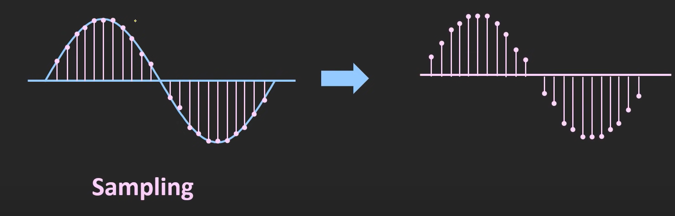
Sampling:
In this process continuous time signal is converted into discrete time signal.
The obtained signal is sampled Signal.

Slide 6
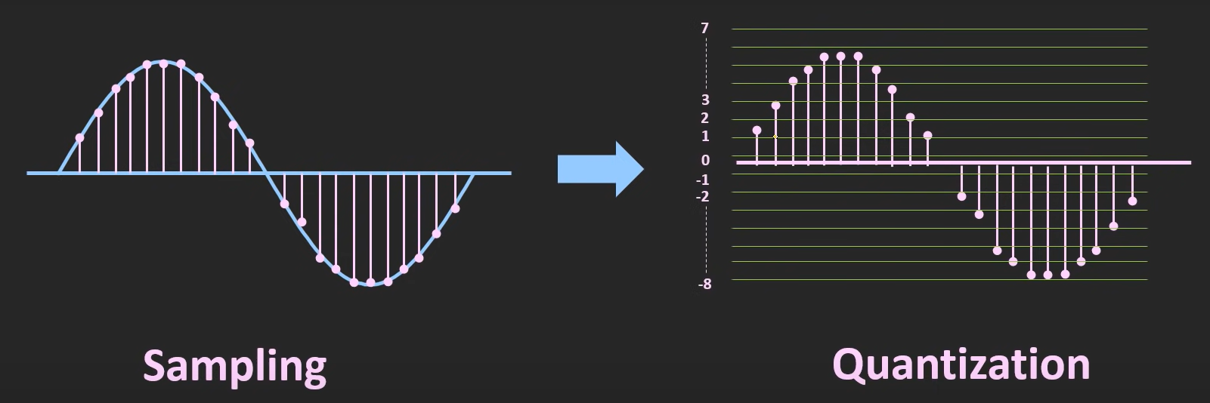
Quantization:
Quantization is a process of assigning a sampled signal a value from the discrete set of values.
Number of bits of ADC (n)
Number of levels to which signal is quantized 2^{n}
Resolution = Vmax - Vmin/ 2^{n}

Slide 7
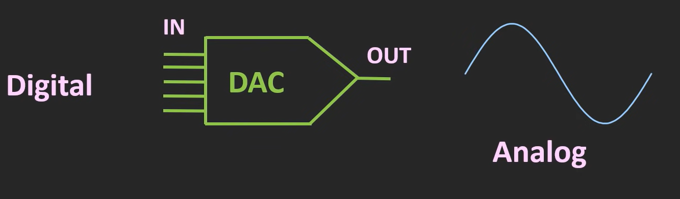
D/A Conversion:
DAC takes Digital signal and converts into Analog form.
Example:
A modem converts computer digital data to analog audio-frequency signals that can be transmitted over telephone lines.

Slide 8
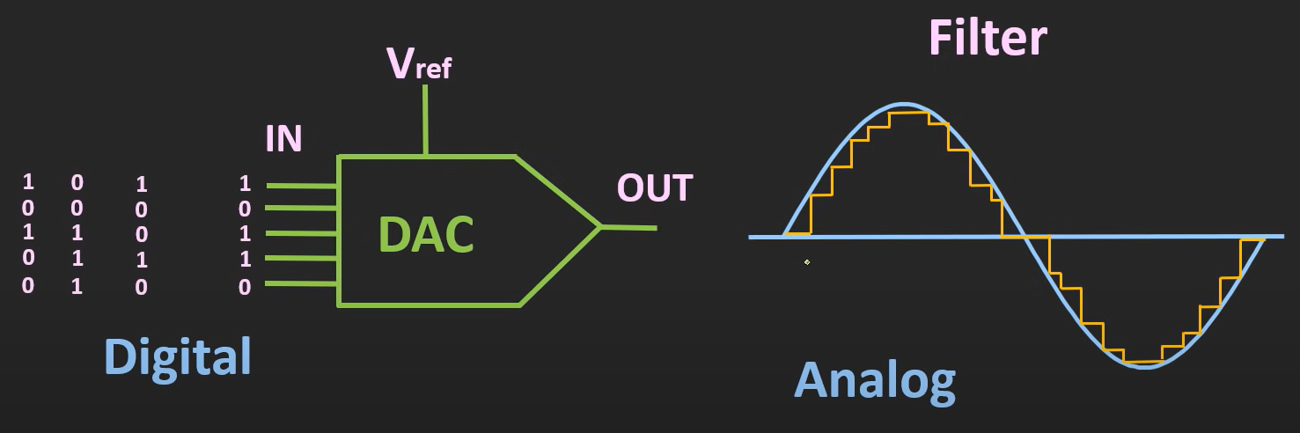
For the particular digital code, we will get the fixed analog output, but if the digital code is changing continuously at the fixed interval, then the output will also change continuously.
By passing the output through the filter, it is possible to smooth out the output. But, the resolution of the DAC decides how closely the output of the DAC matches with the actual waveform.
And by increasing the resolution this step size can be reduced and the output of the DAC will be much closer to the actual waveform.
Number of bits of DAC -- n
Number of levels to which signal is quantized -- 2^{n}
Resolution = Vref / 2^{n}

